Slide 1

Sales Performance Review
[Date]

Slide 2
Overview
Company Introduction: Anike Bridge, a leading player in the fashion and beauty industry, renowned for its innovative designs and high-quality products.
Purpose of Presentation: To review sales performance, identify issues, propose solutions, and outline strategies for future improvement.

Slide 3
Business Model
Revenue Streams: Overview of primary revenue sources (e.g., product sales, partnerships)
Customer Segments: Target demographics and market segments
Value Proposition: Unique selling points and competitive advantages
Cost Structure: Major expenses and cost management strategies

Slide 4
Previous Month Sales Summary and Performance
Total Sales Revenue: $X
Top-Performing Products: List of top 3 products
Sales by Region: Breakdown of sales across different regions
Key Metrics: Conversion rates, average order value, and customer acquisition cost

Slide 5
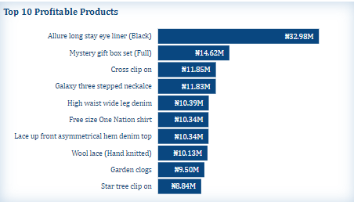
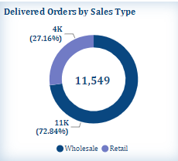
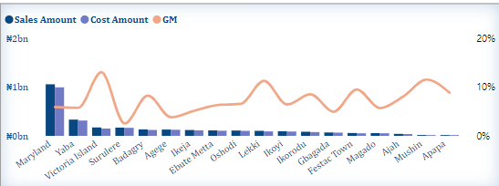
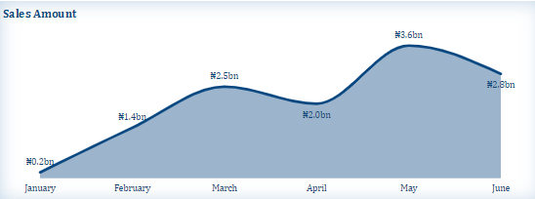
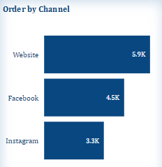
Current Month Summary on Sales Performance

Slide 6
Problems Encountered
Decline in Sales: Specific areas or products showing reduced sales
Customer Feedback: Common complaints or negative feedback trends
Operational Issues: Any logistical or supply chain problems affecting sales
Market Trends: External factors impacting performance

Slide 7
Solutions
Product Strategy: Adjustments or new launches to address declining sales
Customer Service Enhancements: Improving response times and satisfaction
Operational Improvements: Streamlining supply chain and inventory management
Market Adaptation: Adjusting to new trends or market conditions

Slide 8

Competition Analysis
Key Competitors: List and brief overview of main competitors
Competitive Positioning: How Anike Bridge compares in terms of product offering, pricing, and market share
Market Trends: Emerging trends and competitor responses
SWOT Analysis: Strengths, weaknesses, opportunities, and threats

Slide 9

Marketing Plan
Current Strategies: Overview of ongoing marketing campaigns and channels used
Performance Metrics: Effectiveness of current marketing efforts
Upcoming Campaigns: Planned marketing activities and promotions
Budget Allocation: Marketing budget distribution and expected ROI

Slide 10

How to Make Improvements for Next Month
Action Plan: Specific steps to address problems and capitalize on opportunities
Performance Targets: Setting measurable goals for the next month
Resource Allocation: Adjusting budget and resources to focus on key areas
Monitoring and Evaluation: Methods for tracking progress and adjusting strategies as needed

